Slide 1
Microsoft Language Understanding Intelligent Service (LUIS)
[ Instructor Name ]
[ Instructor E-mail ]

Slide 2

Microsoft Language Understanding Intelligent Service (LUIS)
Language Understanding Intelligent Service (LUIS) is an interactive machine learning and language understanding technology and toolset designed to easily add language understanding and semantic interpretation to applications.
Notes:
One of the key problems in human-computer interactions is the ability for a computer to understand what a person really means, and to find the relevant information for a user’s intention. For example, in a news reader or browsing app, a user might say "Find news about global warming," in which case there is the intention to “find news”, and with a topic of “global warming.” LUIS is designed to make it extremely easy to deploy a “model” via an HTTP endpoint that will take the sentences or “utterances” sent to it, and then interpret these utterances in terms of the actual intention. This way, key entities like “global warming" that are present can easily be derived. LUIS also makes it easy to design sets of intentions and entities in a heavily customized way that are relevant to the specific user and application, and then provides guidance as you walk through the process of building a language understanding system.

Slide 3
Language Understanding Concepts
LUIS is part of Microsoft’s Cognitive Services offering and can be used for any device, on any platform, and any application scenario.
Essentially what Cortana uses on the backend for language and sematic interpretations
Provides “built in” logic that can be leveraged “out of the box”
Natural, adaptable, conversational intelligence
Model-based via intents and entities
Notes:
Although LUIS services can be designed and leveraged in any app development scenario, they are also ideal for bot integration due to their intelligent, conversational, and adaptable behavior. LUIS integration is typically managed via “Intent” Dialogs that create a seamless connection between bot logic and semantic interpretations and entities. For large-scale, robust bot development, LUIS is almost a requirement, as the prediction and implementation of complex language analysis will typically be beyond the scope of any application.

Slide 4
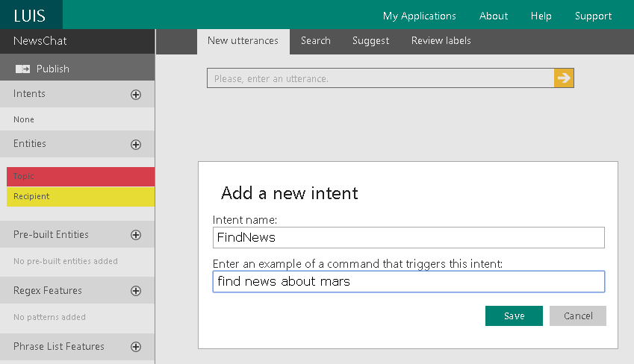
LUIS Terminology
Entities
Intents
Labels
Utterances
Phrase lists
Training
Publishing
Notes:
Many “model-based” artificial intelligence, cognitive services, machine learning, and data science-based platforms use similar terms. Some of these key terms used by LUIS such as “entities”, “intents”, “labels”, “utterances”, “phrase lists”, “training”, and “publishing”. The primary elements of a language understanding model are entities and intents. An intent is simple what a user “intends” to do, and an entity is a clarification of an intent. For example, if a user said “Find news about global warming”, the intent would be to “find news” and the entity would be “global warming”. Entities can also be based on phrase lists, making it easy to refine results to specific values.

Slide 5




General Flow
Create language understanding models.
Use pre-built models from Bing and Cortana.
Deploy your models to an HTTP endpoint.
Access models on any device.
Notes:
The general process for creating and configuring a LUIS application starts with either creating a custom model, or using a pre-built model, then deploying or “publishing” your model to an HTTP endpoint that is then accessible via your application. NOTE: Although models can be shared in an application, models cannot be combined or nested into parent models. If you want to include both custom and pre-built models in your application, these need to be setup as spate applications. This is not true, however for entities. Custom and pre-built entities can be combined as needed.

Slide 6
Pre-built Entities
LUIS includes a set of pre-built entities. When a pre-built entity is included in your application, its predictions will be included in your published app.
Entity | Examples | JSON
builtin.number | ten, 3.1415 | { "type": "builtin.number", "entity": "ten" }
builtin.ordinal | first, 10th | { "type": "builtin.ordinal", "entity": "10th" }
builtin.temperature | 10 degrees celsius, 78 F | { "type": "builtin.temperature", "entity": "78 f" }
builtin.dimension | 2 miles, 650 square kilometers | { "type": "builtin.dimension", "entity": "2 miles" }
builtin.money | 1000.00 US dollars, $ 67.5 B | { "type": "builtin.money", "entity": "1000.00 us dollars" }
builtin.age | 100 year old, 10 years old | { "type": "builtin.age", "entity": "100 year old" }
builtin.geography | seattle, amazon river | { "type": "builtin.geography.city", "entity": "seattle" }
builtin.encyclopedia | geddy lee, diet coke, super bowl xxxix | { "type": "builtin.encyclopedia.music.musician", "entity": “geddy lee" }
builtin.datetime | tomorrow, the meeting ends at 5:30 PM | { "type": "builtin.datetime.date", "entity": "tomorrow", "resolution": { "date": "2015-08-15" } }
Notes:
LUIS includes a set of pre-built entities. When a pre-built entity is included in your application, its predictions will be included in your published application, as well as in the LUIS web UI while labeling.
NOTE: The behavior of pre-built entities cannot be modified. Most pre-built entity are available in all LUIS application locales (cultures). Many of the pre-built entity sets, such as geography and encyclopedia contain “nested” entities. For example, an entity may be defined as “encyclopedia”, then “music”, and then “musician” or “song” in order to full describe the entity and eventual intent.

Slide 7
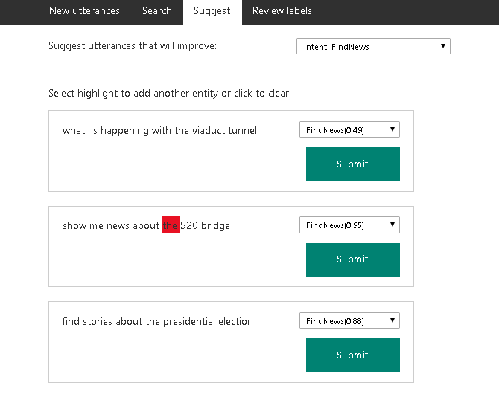
Active Learning
A critical feature of LUIS is the concept of “active” learning. In an active learning scenario, LUIS reviews all the utterances seen, and makes suggestions as to recommended labels.
Notes:
The critical, primary, “breakthrough” feature of LUIS is what’s often referred to as “active learning.” After your endpoint has processed a few “interactions” (meaning LUIS has interpreted a few utterances) you can start leveraging active learning via LUIS suggestions. In the active learning process, LUIS examines all the sentences (utterances) it has seen, and calls your attention to the ones it would recommend for you to label. LUIS is able to critique its own work, including a value based on the likelihood of a matching intent. You access the active learning features directly within a LUIS application by and clicking on "Suggest“, and then from the drop-down menu, selecting a specific entity or intent, such as "FindNews", and then clicking the search icon.

Slide 8



Training a Model
Training a model is the term used when LUIS “generalizes” from the examples you have labeled, and develops code to recognize the applicable intents and entities in the future.
Notes:
When you "train" a model, LUIS generalizes from the examples you have labeled, and develops code to recognize the relevant intents and entities in the future. Internally, LUIS uses logistic regression classifiers to determine intents, and conditional random fields (CRFs) to determine the entities. The training process results in optimized classifiers and CRFs, referred to as models, that LUIS can use in the future. To begin training, just click the "Train" button in a LUIS application. NOTE: Training also automatically occurs periodically.

Slide 9
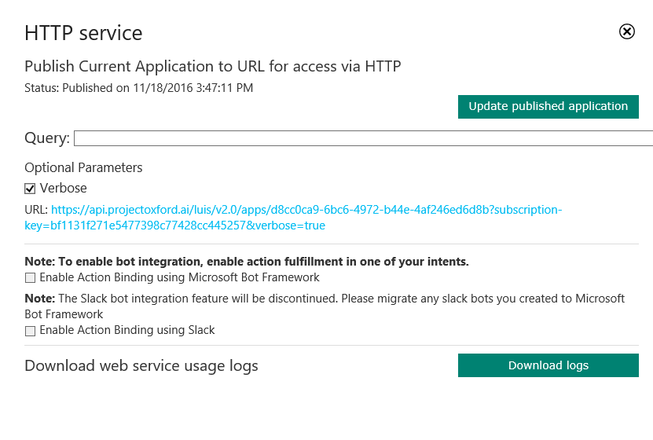
Publishing Models
Before a LUIS model can be made available to an application it needs to be published. Testing and publishing can be accomplished via the same experience.
Notes:
Publishing is the term used when you deploy LUIS models in an HTTP endpoint that will interpret the sentences (or utterances) sent to it. Publishing occurs the first time in the LUIS UI by selecting “Publish web service" and then any future model updates are then published by clicking “Update published application.”

Slide 10
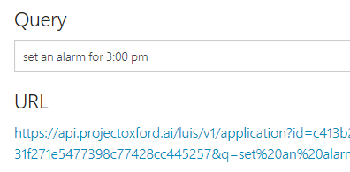
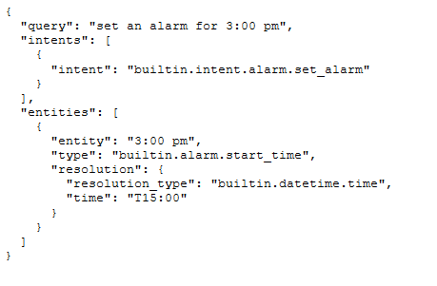
Integrating LUIS
LUIS offers a set of programmatic APIs that can be used by developers to automate the application creation process. These APIs also allow you to author and publish your app to a secure endpoint for access within your app experiences.
Notes:
LUIS offers a set of programmatic APIs that can be used by developers to automate the application creation process, as well as allow you to author and publish your app to a secure endpoint for access within your app experiences. The primary mechanisms for sending and interpreting sentences (utterances) via LUIS are direct, programmatic calls via the published HTTP endpoint, and via LUIS “intent” dialogs when working with the Microsoft Bot Framework.

Slide 11
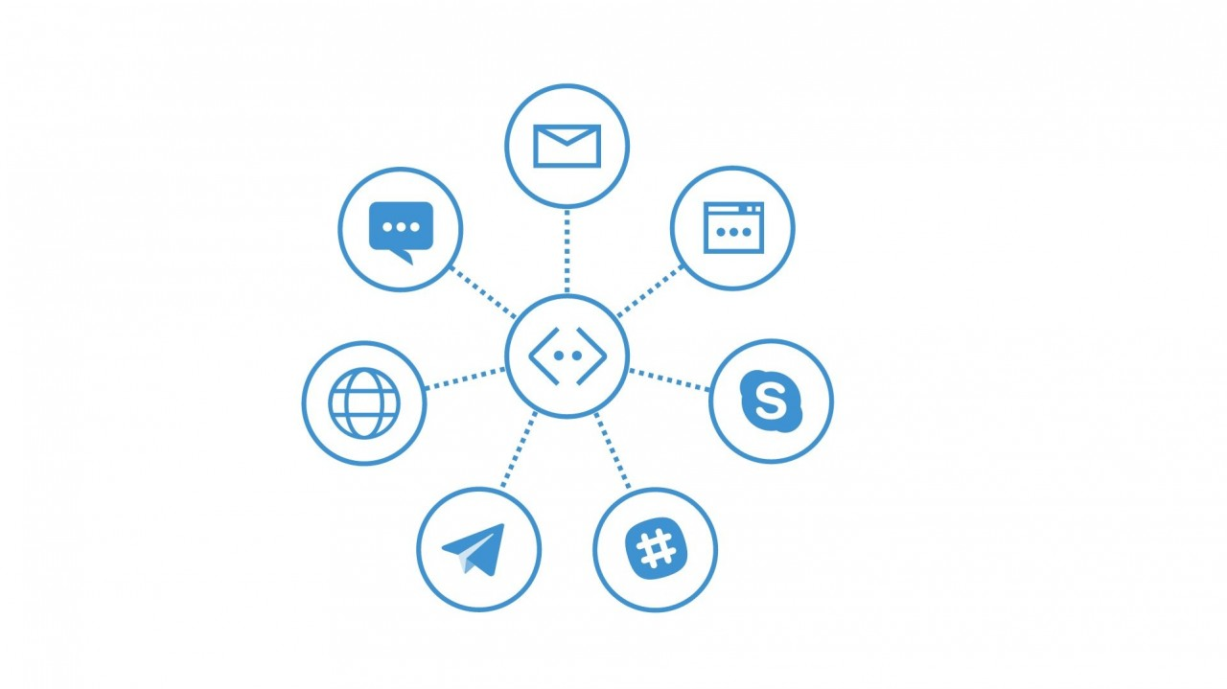

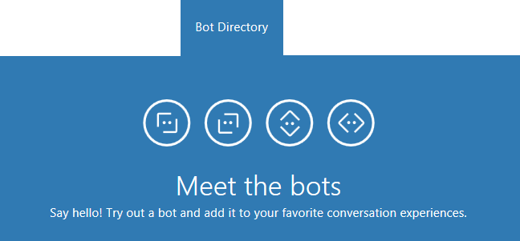
Microsoft Bot Framework
The Microsoft Bot Framework is a comprehensive framework of tools and services developers can leverage to build and deploy high quality, conversational bots in any experience and language.
Notes:
Regardless of the language or platform, developers building bots face the same common challenges: Bots require basic input and output, they need language and dialog skills, they need to be responsive and scalable; and they must connect to users in any conversation experience and language the user chooses. The Microsoft Bot Framework provides the foundation for what developers need to build, connect, manage and publish intelligent bots that interact naturally with users over a variety of services from text/SMS to Skype, Slack, Facebook Messenger, Kik, Office 365 mail and other popular services.

Slide 12
Language & Platform Support
Windows
Mac/Linux
Robust Bot Framework Emulator via .NET
.NET, Node.js, and REST API
Visual Studio Code and higher
Forms via FormFlow
Bot State Service
Integrated Visual Studio templates
Integrated publishing
Simple Bot Framework Emulator via Mono
Node.js and REST API
Visual Studio Code only
Console emulator debugging
Command-line publishing
Notes:
Although the development and deployment of bots can be achieved on any platform the Microsoft Bot Framework provides differing mechanisms and tools depending on the platform and language of choice. The primary toolset for bot development is Visual Studio, in any edition, including Visual Studio Code.

Slide 13
The Connector
The Connector (or Connector Service) handles all communication, conversations, state, and authorization activities between a bot and users.
var connector = new ConnectorClient(incomingMessage.ServiceUrl);
var replyMessage = incomingMessage.CreateReply(“How can I help?”);
await connector.Conversations.ReplyToActivityAsync(replyMessage);
Notes:
The Microsoft Bot Connector is a communication service that helps you connect your bot with many different communication channels (Skype, SMS, email, and others). If you write a conversational bot or agent and expose a Microsoft Bot Framework-compatible API on the Internet, the Bot Framework Connector service will forward messages from your bot to a user, and will send user messages back to your bot. The Connector is the primary mechanism used to communicate all information between a user and a bot, and includes methods to assist with authentication and state management.

Slide 14

Connector Service Flow
CHANNEL
Skype
Web Chat
Email
Facebook
GroupMe
Kik
Slack
Telegram
Twilio
Direct Line
CONNECTOR
Routes messages, manages state, bot registration, tracking, services (such as translation) and per-user and per-bot storage
Your Bot’s Web Service
Notes:
Although all communication between a bot and a channel happens via the Connector., this is not a “technical” requirement, per se, but is instead the entire crux of communicating with diverse channel contracts universally. The Connector handles all the complexity of state management, bot registration, and storage in a way that can extend and apply across all third party services. Communication starts with a user interacting with your bot, then communicating via your bot service, then to the connector, and finally to the third party channel. Responses from the channel always occur in reverse of the user interaction flow.

Slide 15
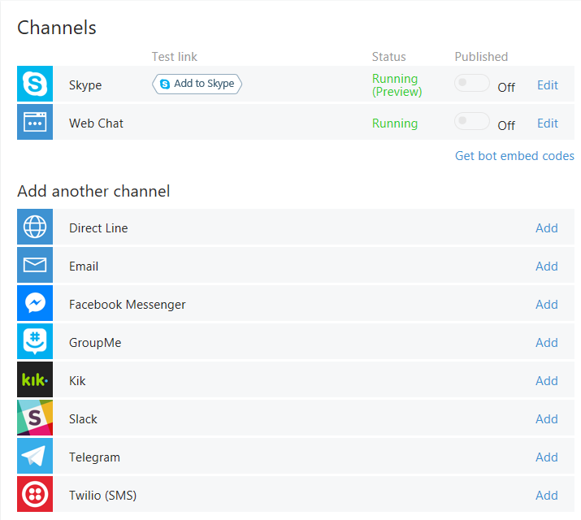
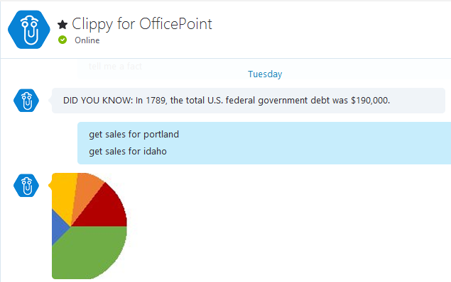
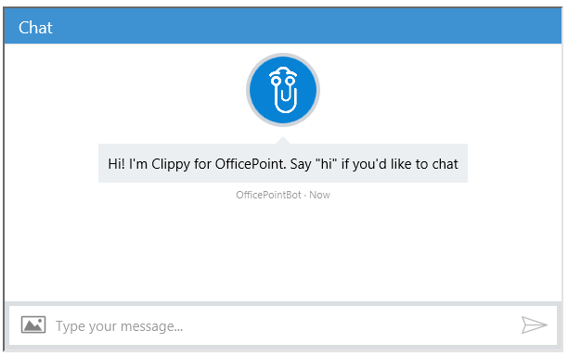
Supported Channels
Channels are currently available for Skype, web, email, Facebook, GroupMe, Kik, Slack, Telegram, Twilio, and direct line app integration.
Notes:
Channels are essentially third party services that a bot can communicate and interaction with in a standardized way. The Microsoft Bot Framework provides developers with a developer portal and SDK to build bots, a Bot Connector service to connect to social channels such as Twitter and Slack, and a Bot Directory to discover and use existing bots.

Slide 16
Hands-On Lab
LUIS HOL.html

